Slide 1
Machine Learning: Unknown Clustering of Bank Clients
Team:
Sarthak Saxena (7717478)
Munkhsaruul Tumbedemberel (7212775)
Jonathan Teja (7717052)
Lukas Barbutev (7716854)
Teruhito Nakajima (7721971)

Slide 2
Agenda
Dataset and Overview
Data Cleaning and Preprocessing
Explorative Data Analysis
Model Fitting
Model Diagnostic
Conclusion

Slide 3
Dataset and Overview

Slide 4
Task
Objective:
Help the bank identify customer groups with varying risk levels of credit repayment.
Approach:
Utilize clustering analysis to categorize customers into distinct groups based on their credit behavior and financial attributes.
Goal:
Risk Segmentation: Identify high, medium, and low-risk customer groups.
Customized Strategies: Tailor credit policies and strategies based on risk profiles.
Improved Decision Making: Enhance loan approval processes and minimize potential losses.

Slide 5
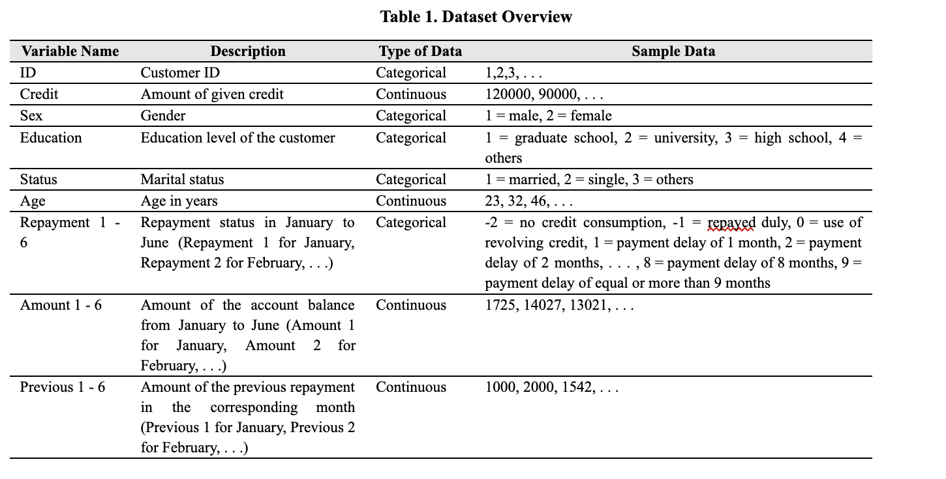
Dataset
I

Slide 6
Data Cleaning and Preprocessing

Slide 7
Data Cleaning & FEATURE ENGINEERING
We followed the classical procedure of Data cleaning.
Checking for Null Values
Checking for duplicates
Removing missing values
Neither, Null Values, nor duplicates or missing values were found. Therefore, no data points were dropped.
To facilitate the later explorative Data Analysis and Model building we created new features that allowed us to make more meaningful statements about the data.

Slide 8
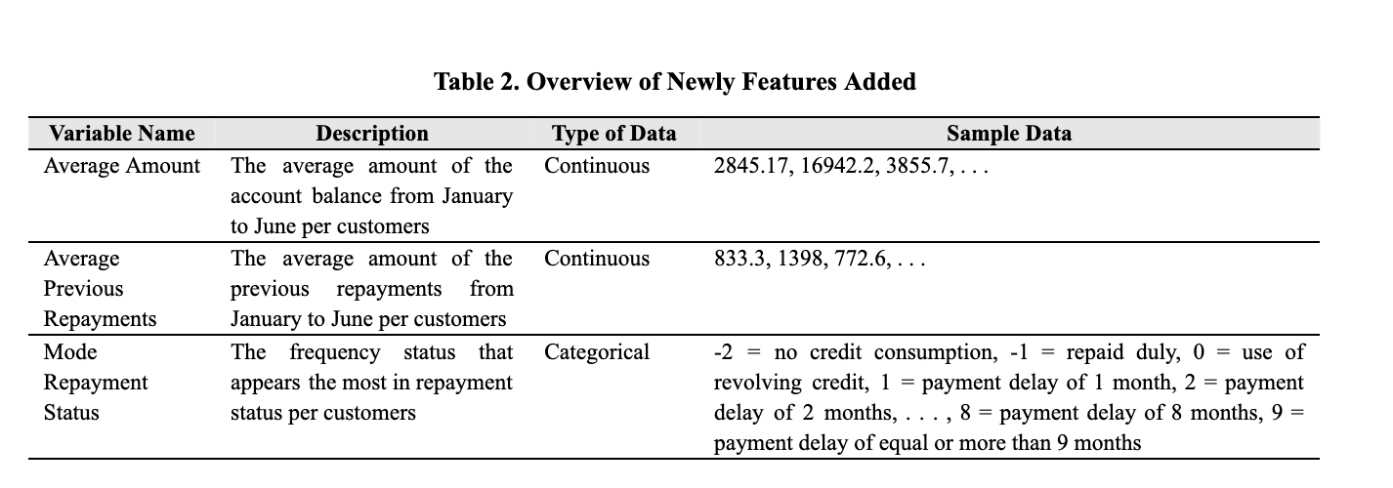
FEATURE ENGINEERING

Slide 9
Explorative Data Analysis 1. Categorical 2. continuous

Slide 10
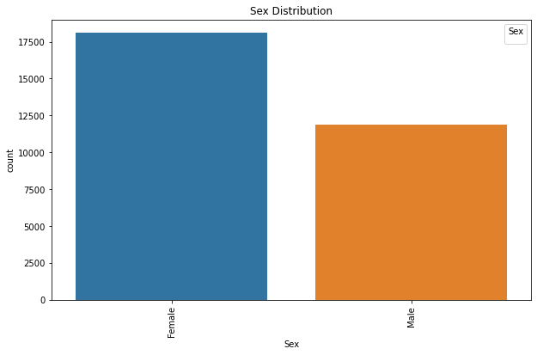
1.) Distribution OF Sex
Categories | Amount
Female | 18111
Male | 11888
Total | 29999
Key Insight: More female customers.

Slide 11
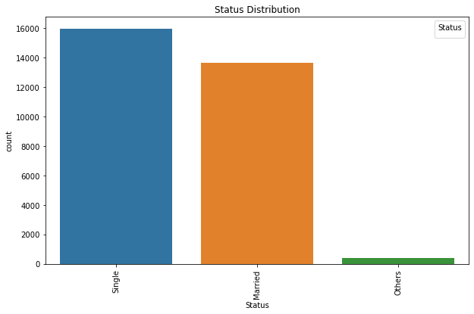
1.) Distribution of Status
Categories | Amount
Single | 15964
Married | 13658
Others | 377
Total | 29999
Key Insight: Higher amount of married customers

Slide 12
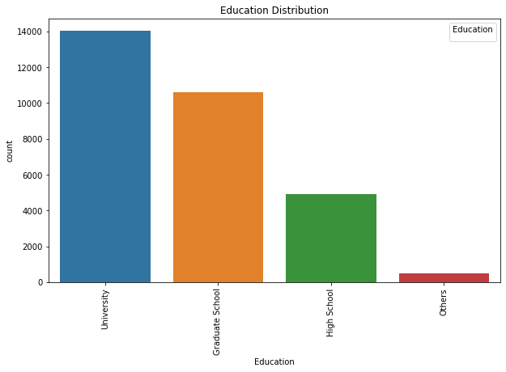
1.) Distribution of Education
Categories | Amount
University | 14029
Graduate School | 10585
High School | 4917
Others | 468
Total | 29999
Key Insight: Higher share of educated customers

Slide 13
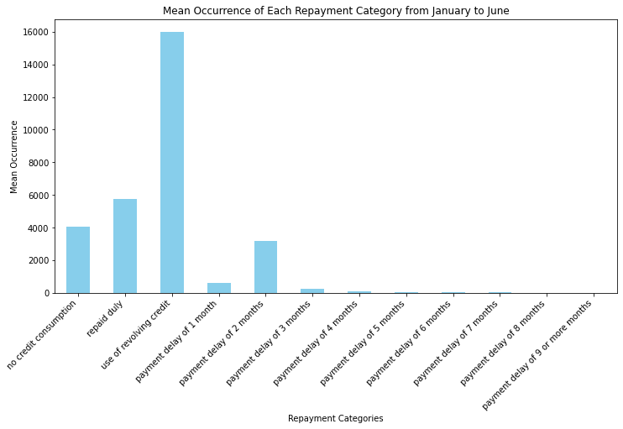
1.) Distribution of Mean Repayment Status
Categories | Amount
No credit | 4048
Use of credit | 15986
Repaid duly | 5773
Delay of 1 months | 620
Delay of 2 months | 3160
Delay of 3 months | 238
Delay of 4 - 8 months | > 100
Delay of 9 months | n/a

Slide 14
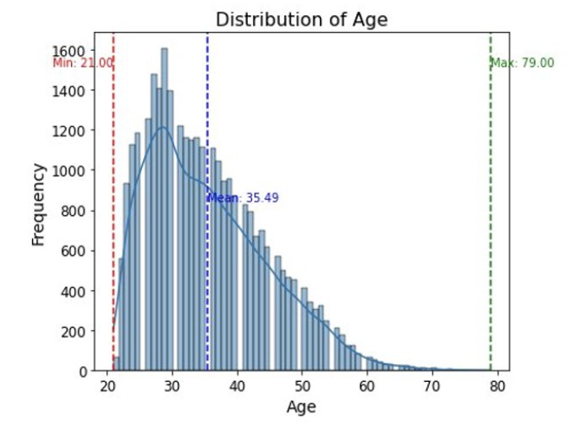
2.) Distribution of Age
Age Distribution:
Range: 21 to 79 years
Mean Age: 35.49 years
Key Insight: Higher concentration of younger individuals

Slide 15
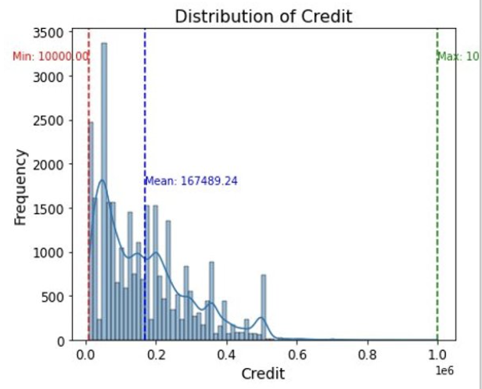
2.) Distribution of average Credit
Credit Distribution:
Range: 10,000 to 1,000,000
Mean Credit: 167,489.24
Key Insight: Distribution is highly skewed towards lower values, with a few outliers holding significantly higher credit amounts

Slide 16
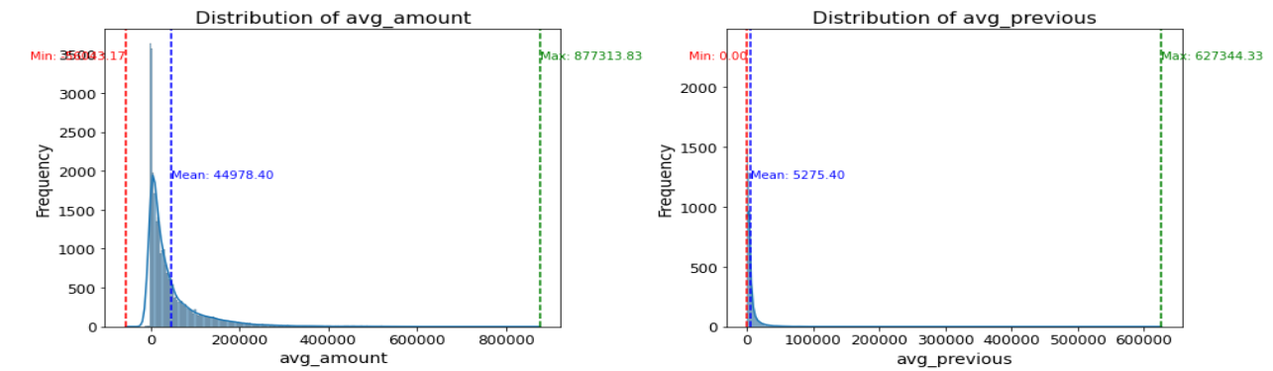
2.) Distribution of average amount vs. AVERAGE PREVIOUS REPAYMENT
Distribution: Highly skewed with most individuals clustered around low values
Key Insight: Presence of outliers with the majority of data points concentrated in a narrow range

Slide 17
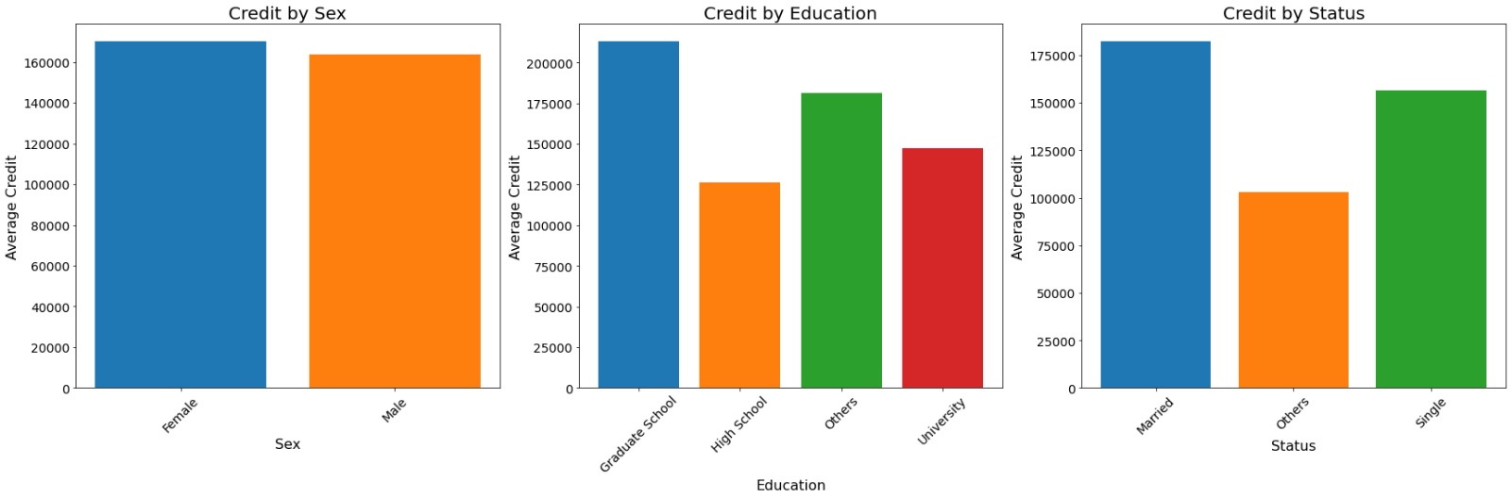
credit by categorical variables
Categories | Amount
Female | 170095
Male | 163519
Key Insight: The average credit for both females and males is very similar, with females slightly leading.

Slide 18
credit by categorical variables
Categories | Amount
Graduate School | 212956
University | 1226550
Others | 181316
High School | 147071
Key Insight: Individuals with a Graduate School education have the highest average credit. Those with a High School graduates have the lowest average credit.

Slide 19
credit by categorical variables
Categories | Amount
Married | 182213
Others | 103077
Single | 156414
Key Insight: Married individuals have the highest average credit. Single individuals have a moderately high average credit.

Slide 20
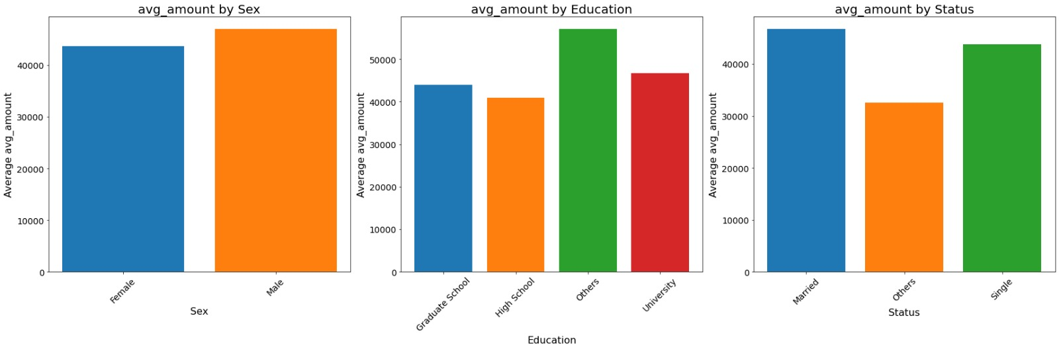
Average amount by categorical variables
Categories | Amount
Female | 43650
Male | 47000
Key Insight: The average amount is slightly higher for males compared to females.

Slide 21
Average amount by categorical variables
Categories | Amount
Graduate School | 43969
High School | 40984
Others | 57085
University | 46736
Key Insight: “Others” category leads with the highest average amount. Graduate School and University categories follow, with High School having the lowest average amount.

Slide 22
Average amount by categorical variables
Categories | Amount
Married | 46770
Others | 32572
Single | 43783
Key Insight: Married individuals have the highest average amount, similar to their credit pattern. Single individuals also have a high average amount, but less than married individuals.

Slide 23
Summary of Eda
The data shows trends of a higher representation of females and a predominance of individuals with higher educational qualifications.
Married individuals have higher credit and account balance.
Distributions of continuous variables are highly skewed to lower values with the outliers having significantly larger figures.

Slide 24
Model Fitting
K-means, DBScan

Slide 25
mODEL INTRODUCTION
K-Means Clustering
The K-means algorithm clusters data into a predefined number of groups (k) by iteratively adjusting cluster positions based on the nearest observations until the desired result is achieved.
It is only applicable to continuous data due to the limitations of Euclidean distance for categorical data.
DB-Scan
DBSCAN clusters data by identifying regions with a certain density and effectively handles arbitrary shapes in noisy spatial datasets.
It requires specifying an ϵ-neighbourhood (radius) and the minimum number of core points within that radius to initiate cluster formation.
Clusters expand by including border points until no more data points can be added, and the process repeats until all points are clustered.

Slide 26
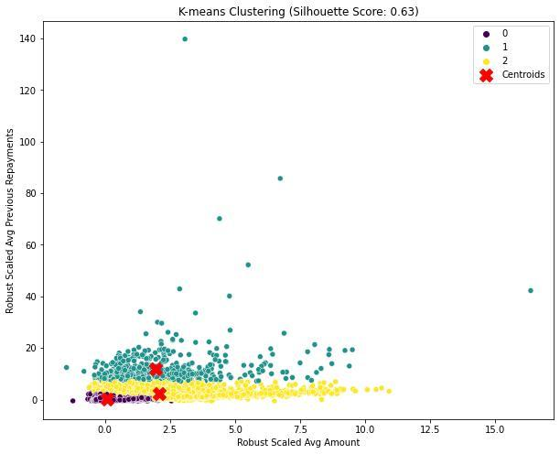
K-Means clustering
We use continuous data for K-means clustering, creating two models: one with Average Amount and Average Previous Repayments to represent customer financial behavior directly.
Including features like age and credit is avoided to reduce noise, as these can be influenced by external factors unrelated to spending and repayment behaviors.
The second model uses all continuous variables, excluding Average Amount and Average Previous Repayments, applying PCA to reduce dimensions while preserving information

Slide 27
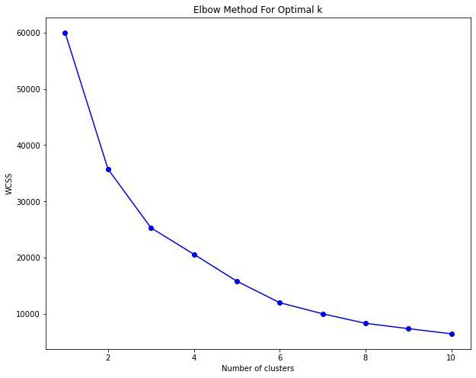
K-Means clustering
We use Robust scaler as the main standardizer across our findings
The optimal number of clusters is determined using the elbow score, with three being optimal for two features.
The silhouette score measures clustering quality, ranging from -1 to 1, with higher scores indicating better cluster separation.
Based on the silhouette score, the clusters are optimal, with Cluster 0 showing the highest density and consistency compared to Clusters 1 and 2.

Slide 28
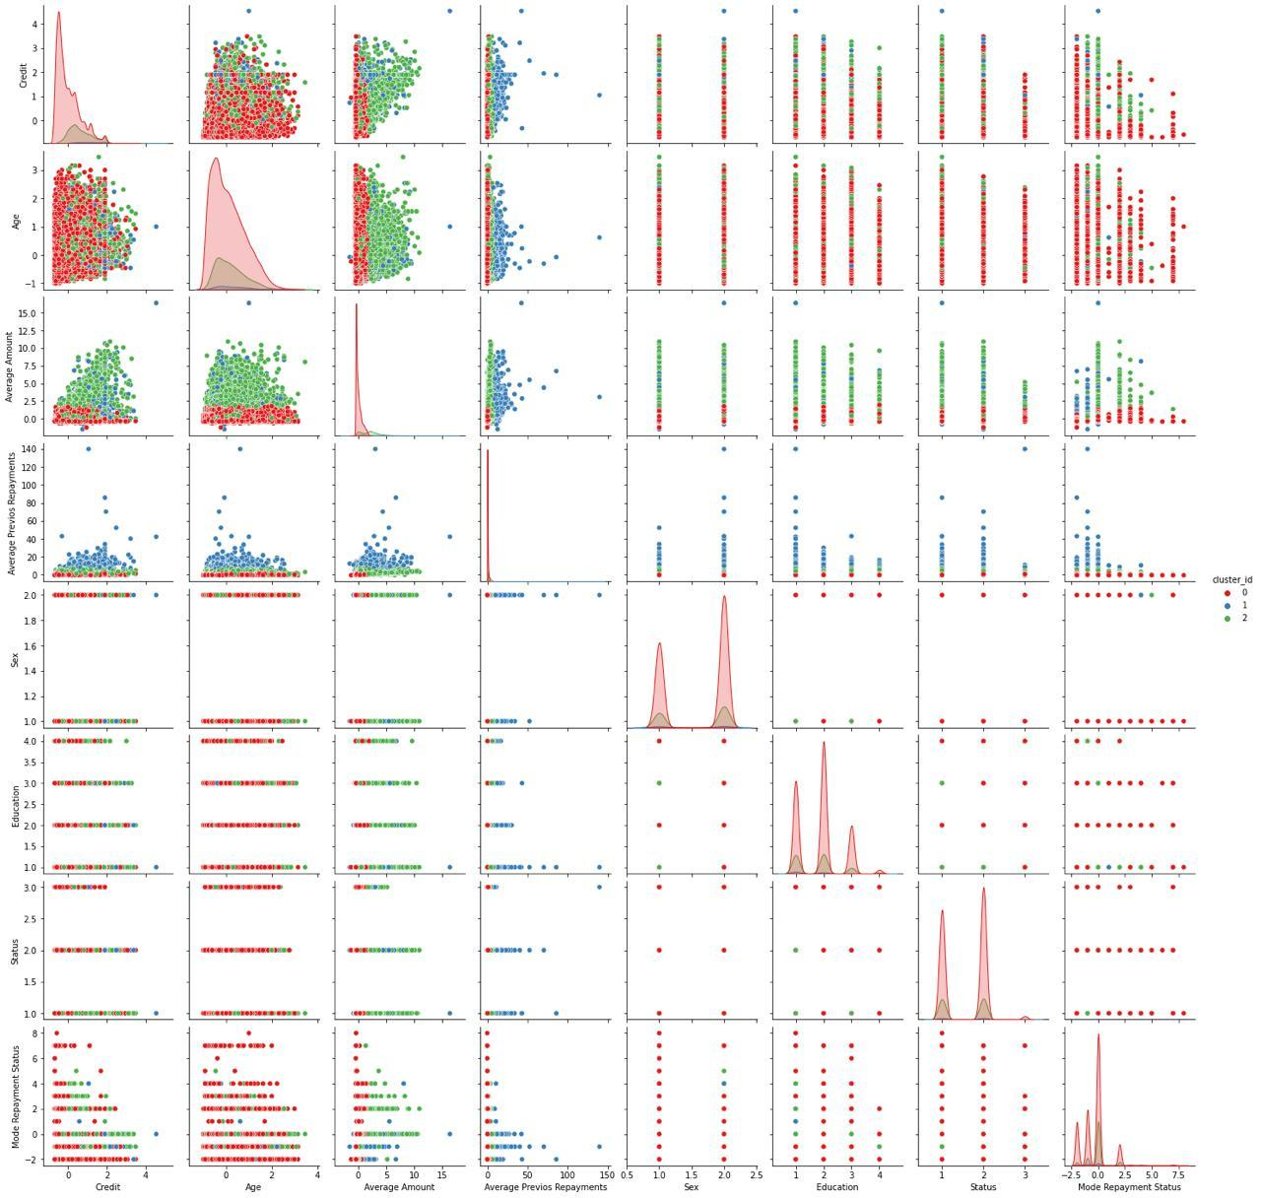
K-Means clustering
Pair -Plotting results without PCA

Slide 29
K-Means clustering
Plotting results with two features, without PCA
1. Clusters Based on Age:
No clear clustering; clusters are overlapping.
2. Credit:
Better separation observed in credit-related features.
Credit vs. Average Amount:
Cluster 2 is the most dominant.
Credit vs. Average Previous Repayments:
Cluster 1 is the most dominant.
3. Average Amount vs. Average Previous Repayments:
Clear and meaningful clustering:
Cluster 1: Highest average amounts and previous repayments.
Cluster 0: Lowest values for both variables.
4. Categorical Variables (Sex, Education, Status, Mode Repayment Status):
Overlapping clusters makes interpretation not possible
Conclusion:
K-Means clustering shows meaningful patterns in some feature combinations, particularly financial metrics.
Clustering based on categorical variables requires further analysis due to overlap

Slide 30
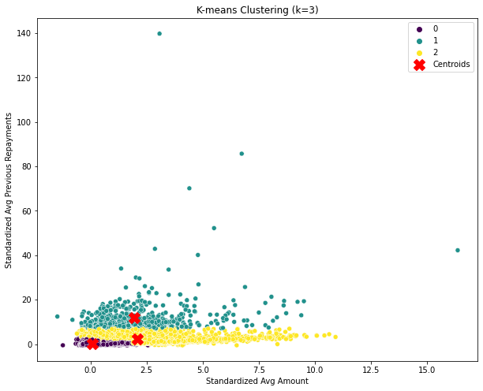
K-Means clustering
Model Diagnostics
Robust Scaler results
Descriptive Statistics
Frequency of points in each cluster for k=3
0 | 24,207
1 | 574
2 | 5218
Density points in each cluster for k=3
0 | 80.26%
1 | 1.91%
2 | 17.39%
Variables inc: Average Amount and Average Previous Repayments.

Slide 31
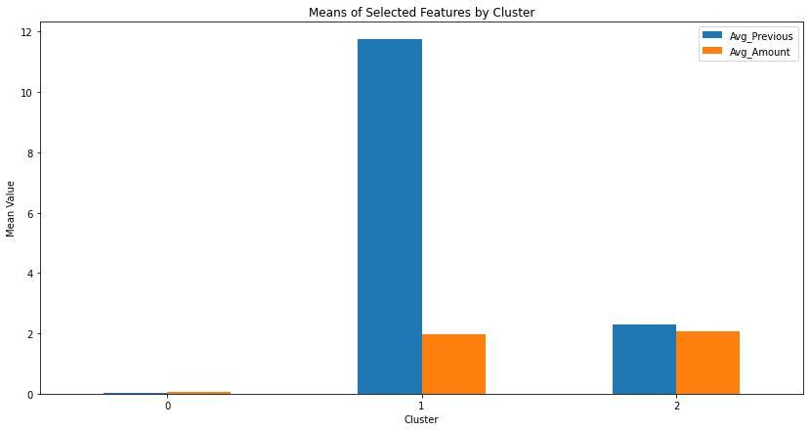
Cluster profiling - K-means with 2 features
Risk Classification:
Cluster 0: High-risk clients
Cluster 1: Low-risk clients
Cluster 2: Medium-risk clients
Repayment Likelihood:
Cluster 1: Most likely to repay
Cluster 2: Less likely to repay than Cluster 1
Cluster 0: Least likely to repay
Account Balance:
Cluster 2: Highest account balance among clusters
Average Previous Repayment:
Cluster 0: Lowest among clusters

Slide 32
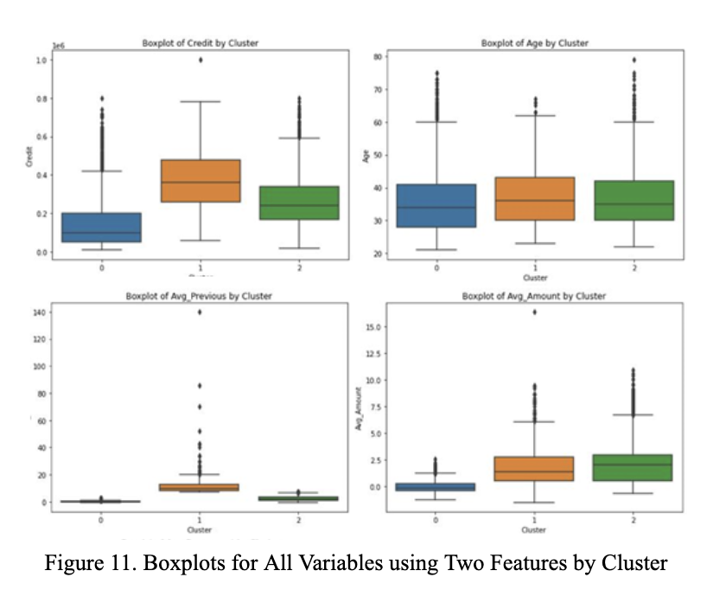
Cluster Profile - K-means with 2 features
Cluster 1:
Highest amount of credit given
Highest average previous repayment
Oldest age
Cluster 0:
Lowest amount of credit given
Lowest average previous repayment
Lowest account balance
Youngest age
Cluster 2: Highest amount of account balance among clusters

Slide 33
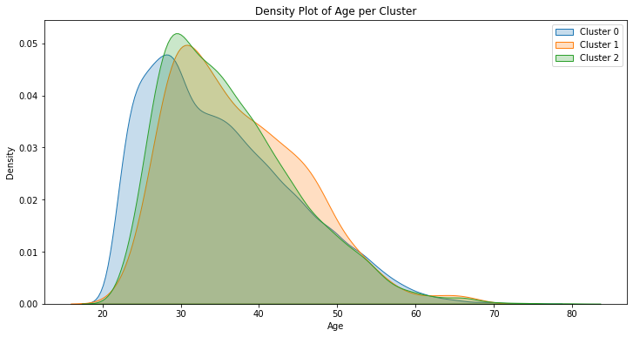
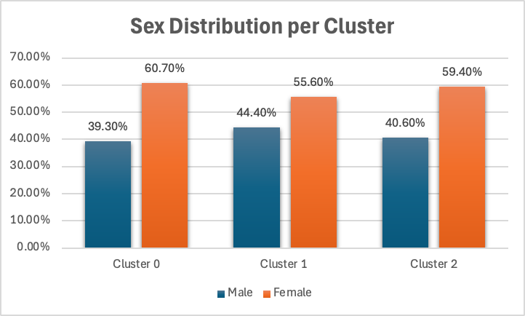
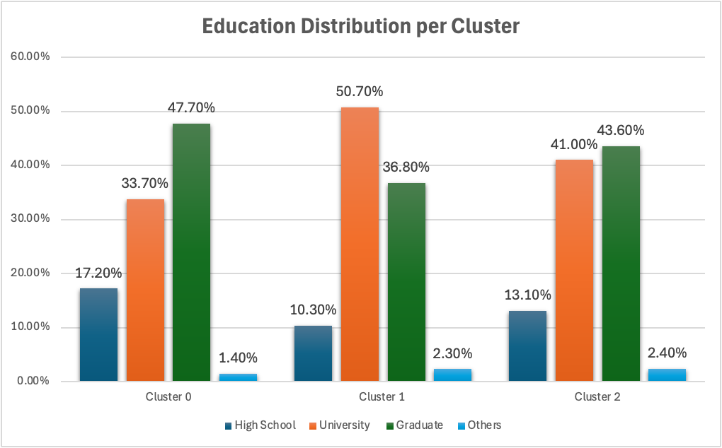
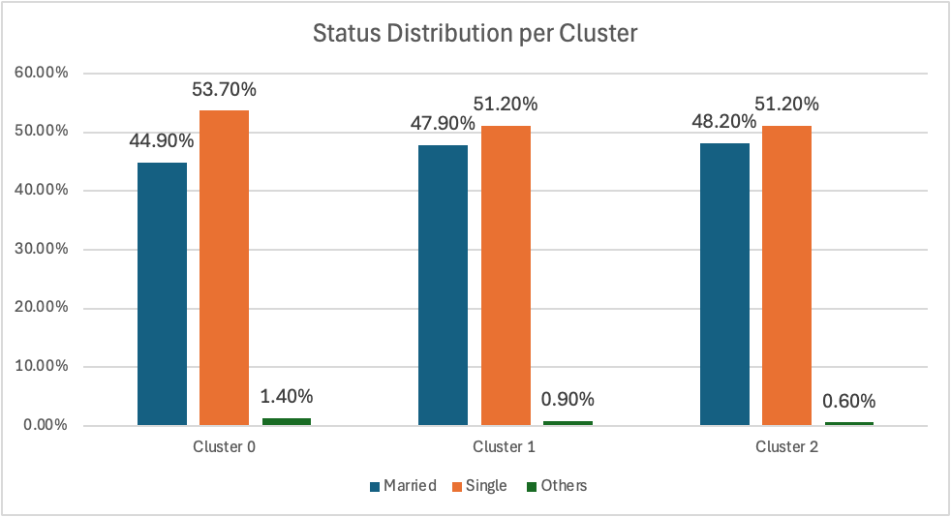
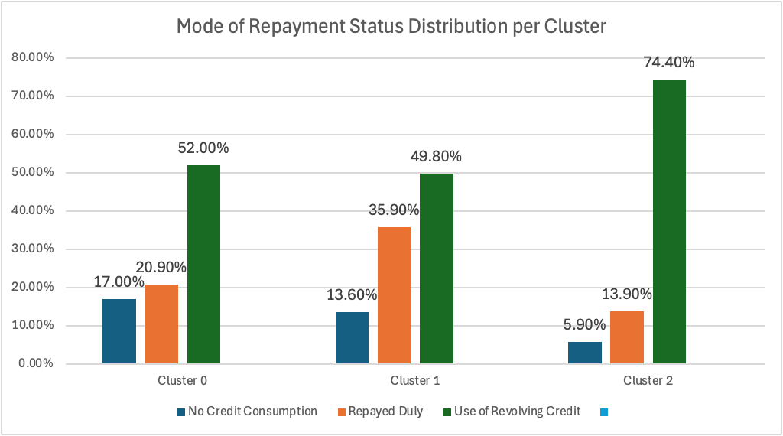
K-Means clustering
Plotting results without PCA

Slide 34
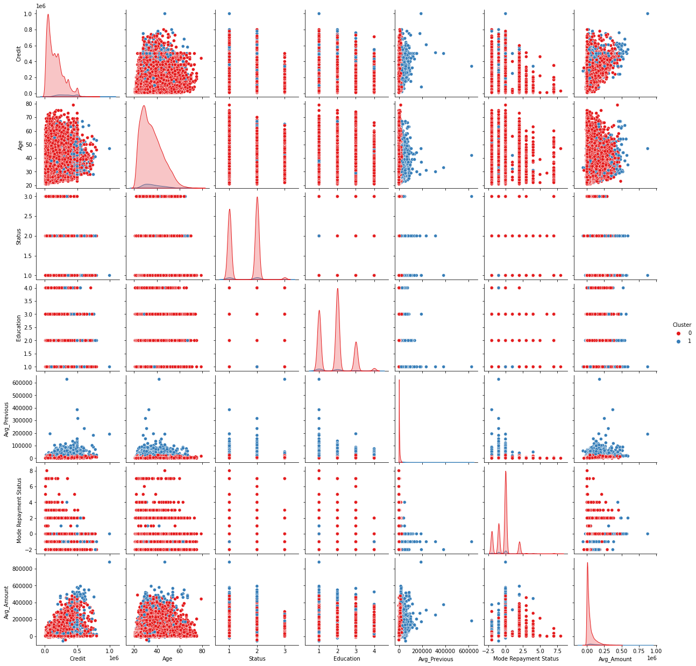
K-Means clustering
Plotting results with PCA

Slide 35
K-Means clustering
Plotting results with two features, with PCA
1. Clusters Based on Age:
No clear clustering; clusters are overlapping.
2. Credit:
No clear clustering; clusters are overlapping.
Credit vs. Average Amount:
Cluster 1 is the most dominant.
Credit vs. Average Previous Repayments:
Cluster 1 is the most dominant.
3. Average Amount vs. Average Previous Repayments:
Clear and meaningful clustering:
Cluster 1: Highest average amounts and previous repayments.
Cluster 0: Lowest values for both variables.
4. Categorical Variables (Sex, Education, Status, Mode Repayment Status):
Better/ clearer with PCA
Conclusion:
K-Means with PCA dimensionality clustering shows meaningful patterns in some feature combinations, particularly financial metrics.

Slide 36
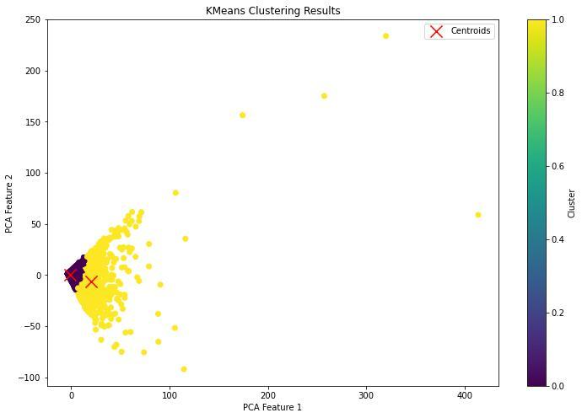
K-Means clustering
Model Diagnostics
Robust Scaler results with PCA
Descriptive Statistics
Frequency of points in each cluster for k=2
0 | 28,684
1 | 1,315
Density points in each cluster for k=2
0 | 95.60%
1 | 4.40%
Variables included: Age, Credit, Amount 1-6, Previous 1-6.

Slide 37
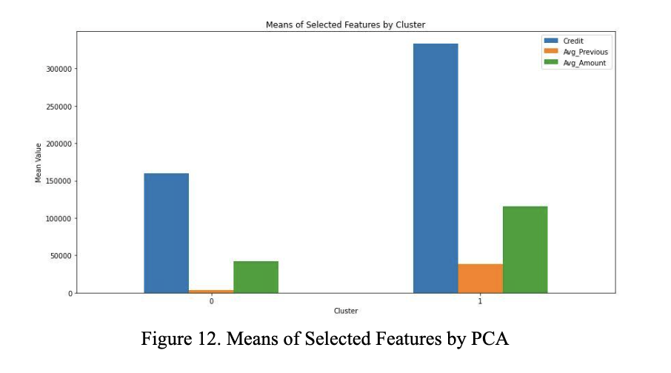
Cluster profile by pca
Risk Classification:
Cluster 0: High-risk clients
Cluster 1: Low-risk clients
Repayment Likelihood:
Cluster 0: Least likely to repay
Cluster 1: Most likely to repay
Account Balance:
Cluster 1: Higher account balance among clusters
Average Previous Repayment:
Cluster 0: Lowest among clusters

Slide 38
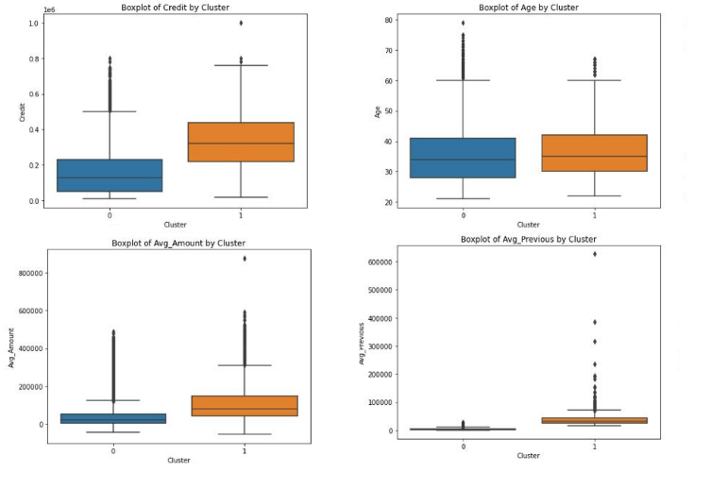
Cluster profile with pca
Cluster 1:
Higher amount of credit given
Higher average previous repayment
Older age
Cluster 0:
Lower amount of credit given
Lower average previous repayment
Lower account balance
Younger age

Slide 39
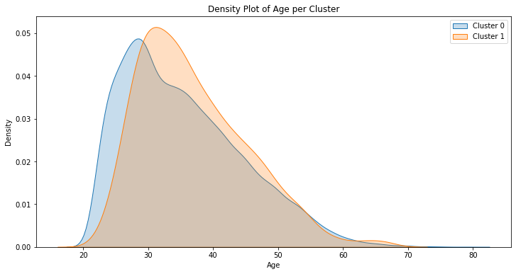
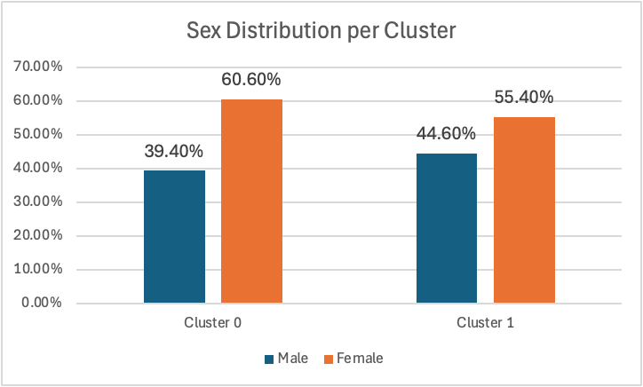
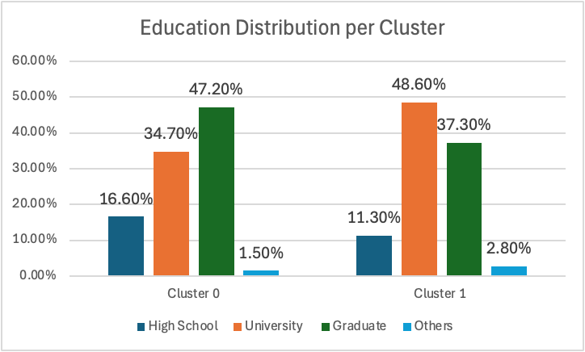
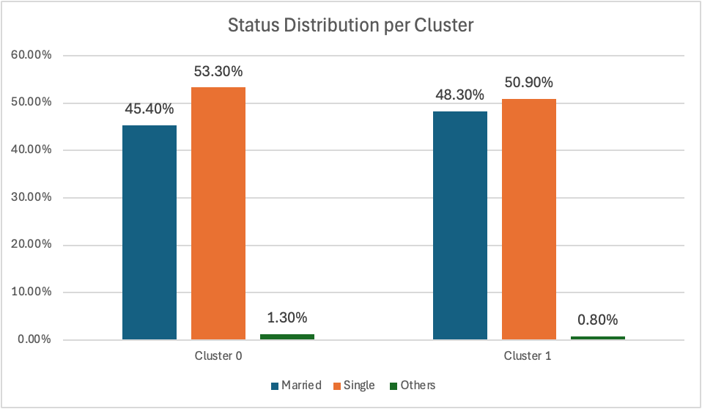
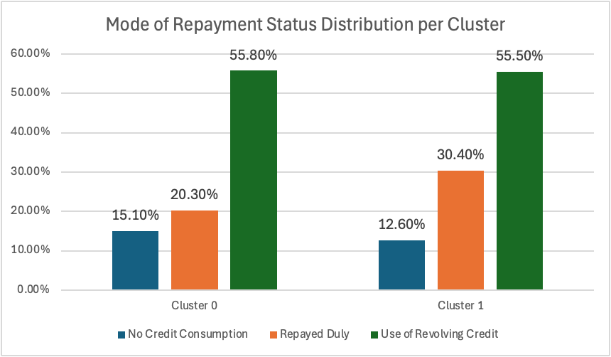
K-Means clustering
Plotting results without PCA

Slide 40
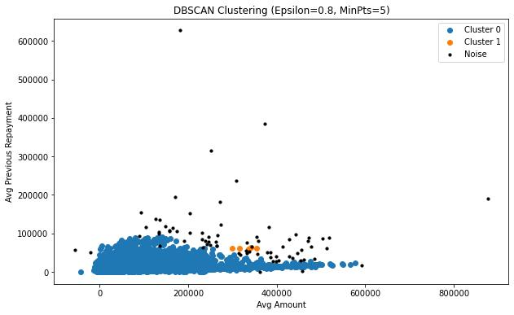
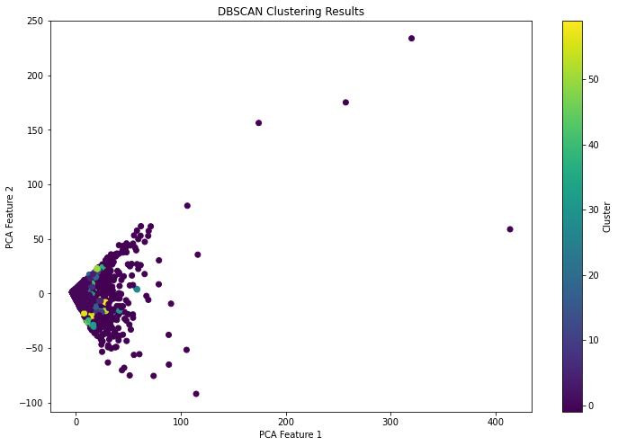
DB-Scan
Purpose:
Clusters regions based on density
Handles arbitrary shapes in noisy datasets
Key Parameters:
ϵ-neighborhood (Epsilon): Radius around a data point
MinPts (Minimum Points): Minimum number of points within ϵ to form a core point
Algorithm Steps:
Set Parameters: Define ϵ and MinPts
Identify Core Points: Points with MinPts within their ϵ-neighborhood
Expand Clusters: Grow clusters by including reachable points until no more can be added
Repeat: Finalize cluster and move to the next core point until all points are processed

Slide 41
DB-Scan vs K-Means
DBSCAN Limitations:
Inconsistent Clustering:
Does not effectively demonstrate clustering tendency.
Similar results across different epsilons and minimum points.
No clear clusters identified.
K-means Advantages:​
Reliable Clustering:​
Demonstrates clear clustering tendency​.
Provides distinct clusters within the data​.
Conclusion:​​
DBSCAN: Not reliable for this dataset​​
K-means: More effective in identifying clear clusters​​

Slide 42
Model diagnostics and Conclusion

Slide 43
Evaluation strategy
To evaluate our different Cluster-models we used the Silhouette Score. The Silhouette score is a metric used to calculate the goodness of a clustering technique. Its value ranges from -1 to 1. The higher the score, the better. 1 means clusters are well apart from each other and better distinguished. 0 means clusters are indifferent or the distance between clusters is not significant. -1 means clusters are assigned in the wrong way necessary

Slide 44
Evaluation
Algorithm | Index | Value
K-Means with two features | Silhouette Score | 0.63
K-Means with PCA | Silhouette Score | 0.838
DB-Scan with two features | Silhouette Score | 0.835
DB-Scan with PCA | Silhouette Score | 0.665

Slide 45
Best result - clustering with PCa gives us 2 cluster
Cluster 0 (High-Risk)
Characteristics:
Clients with lower average previous repayments, lower account balances, and lower amounts of credit given.
Higher proportion of females, individuals with high school education and graduates, and single individuals.
Consistent with previous findings.
Cluster 1 (Low-Risk)
Characteristics:
Clients with higher average previous repayments, higher account balances, and higher amounts of credit given.
Higher proportion of males, individuals with university and other types of education, and slightly more married individuals.
Consistent with earlier analysis.

Slide 46
Conclusion
DB-Scan and K-means yield similar results. However, DB-Scan is not interpretable, which might be to overfitting.
K-means with average amount and average balance leads to three clusters and a Silhouette score of 0,63
K-means with PCA is our best result with a Silhouette score of 0.838

Slide 47

FIN.

Slide 48
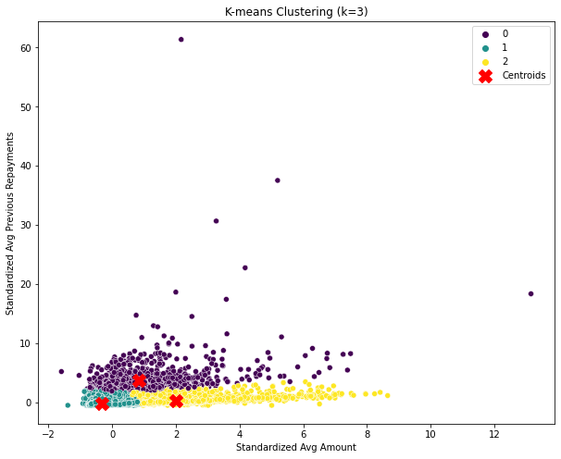
K-Means clustering
Model Diagnostics
Standard Scaler results
Descriptive Statistics
Frequency of points in each cluster for k=3
0 | 993
1 | 25,160
2 | 3846
Density points in each cluster for k=3
0 | 3.30%
1 | 83.86%
2 | 12.82%

